Slide 1
TalentBridge
Demo video for the API
By Anas Asimi and JohnIan Ong’ayi

Slide 2
What is TalentBridge?
The TalentBridge API provides endpoints to manage job postings, retrieve job information, handle job applications, and support user interactions such as applying to jobs, and tracking application status.

Slide 3


Requirements
Node.js
MongoDB >= 7.x

Slide 4
Setup
01
02
Clone the repository
Install dependencies
03
04
Setup environment variables
Start the server

Slide 5
API Showcase

Slide 6
01
/users
Sign Up Users

Slide 7
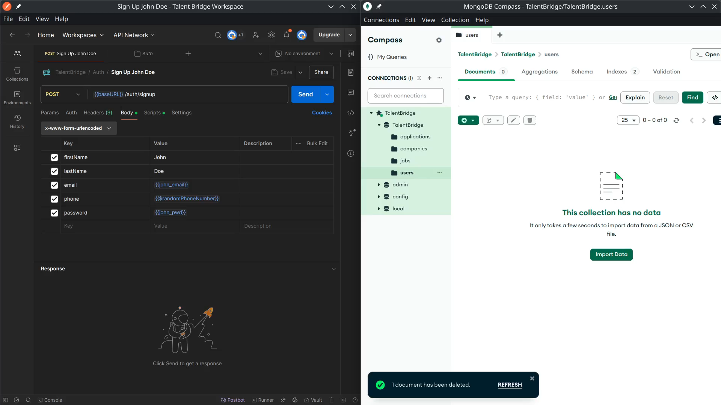

Slide 8
01
/users
Log in Users

Slide 9
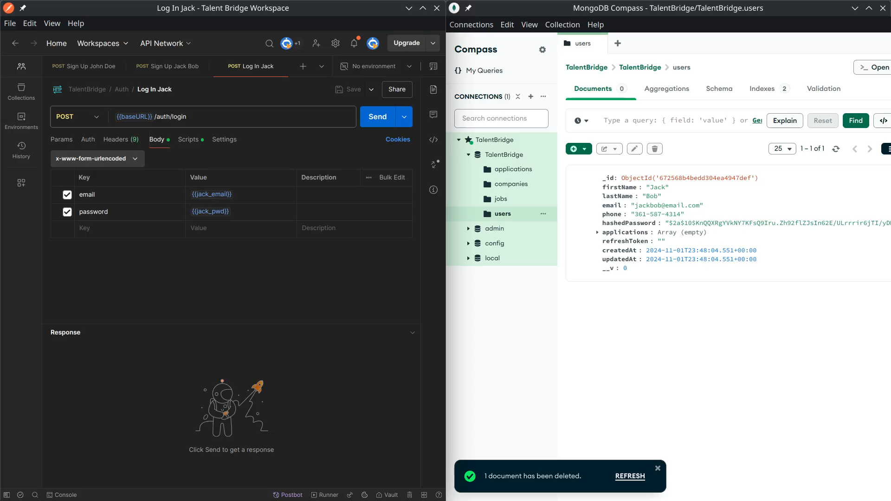

Slide 10
02
/companies
Create Companies

Slide 11
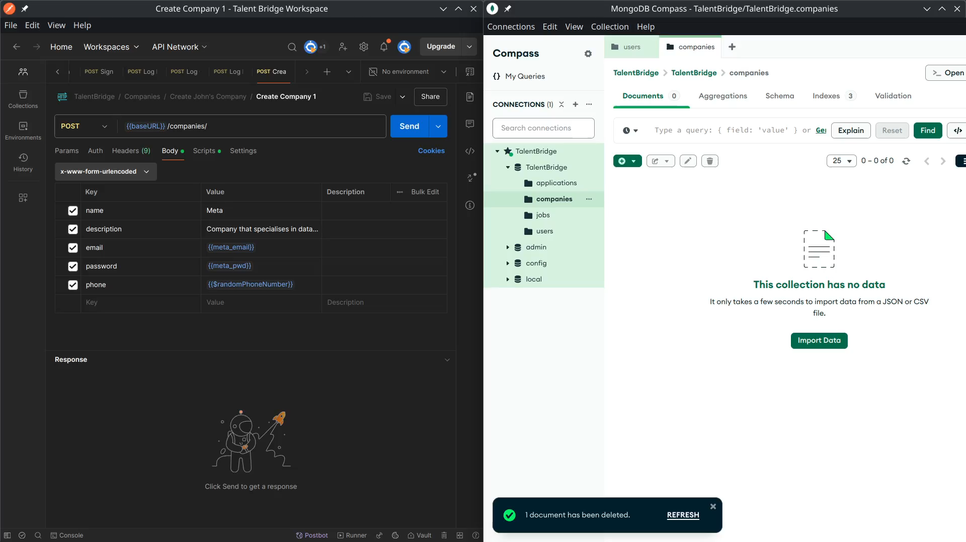

Slide 12
02
/companies
Fetch Company By ID

Slide 13
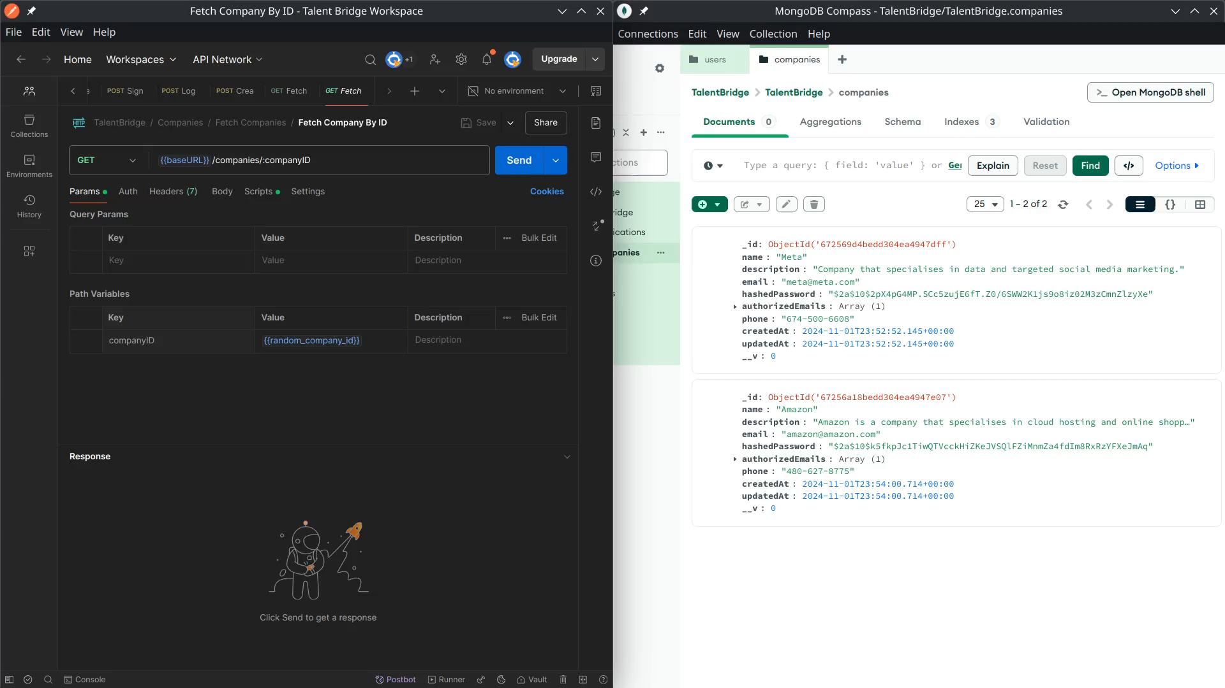

Slide 14
03
/jobs
Create Jobs

Slide 15
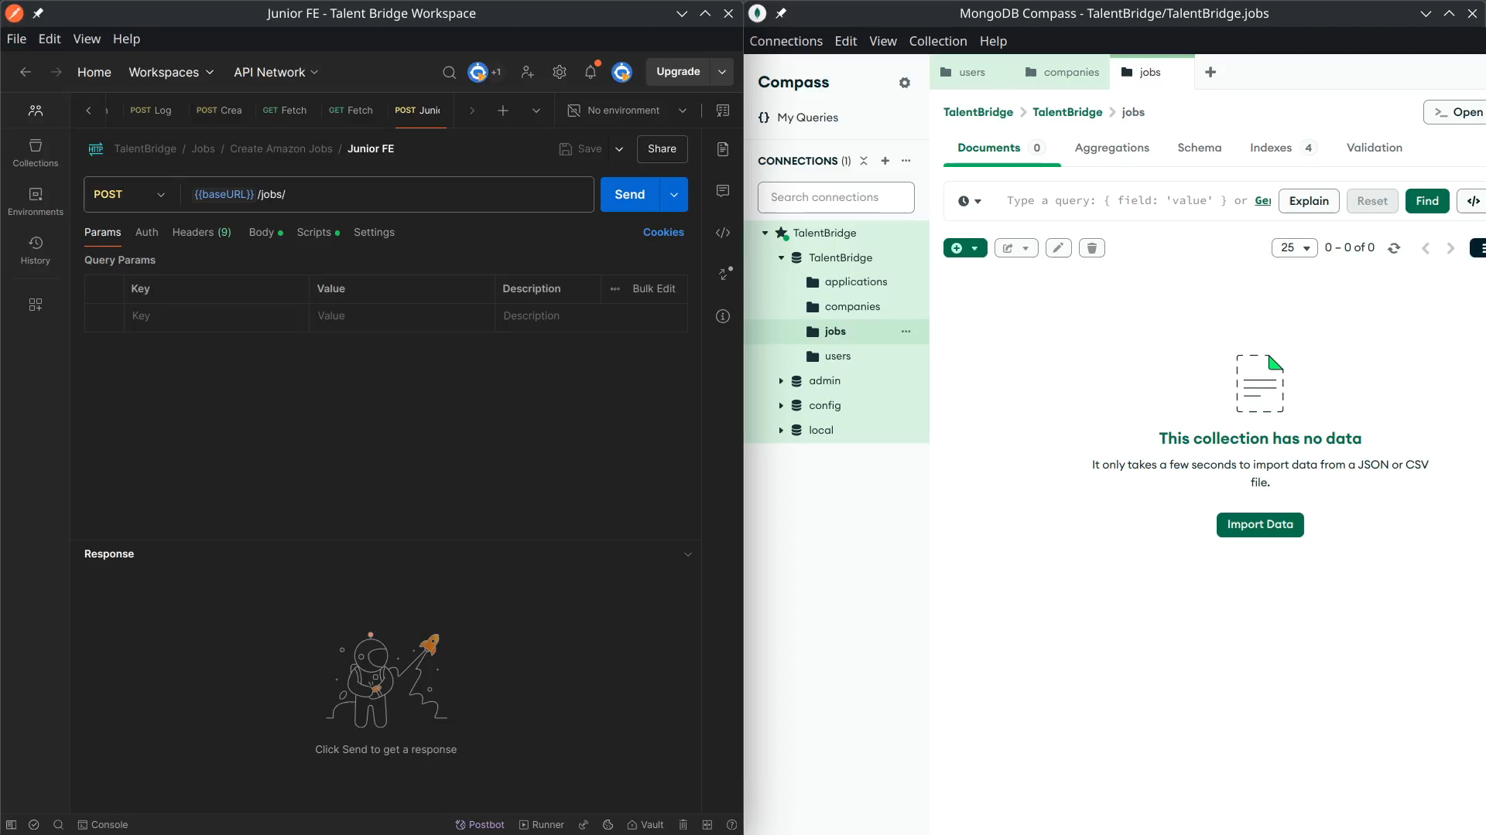

Slide 16
03
/applications
Send Applications

Slide 17
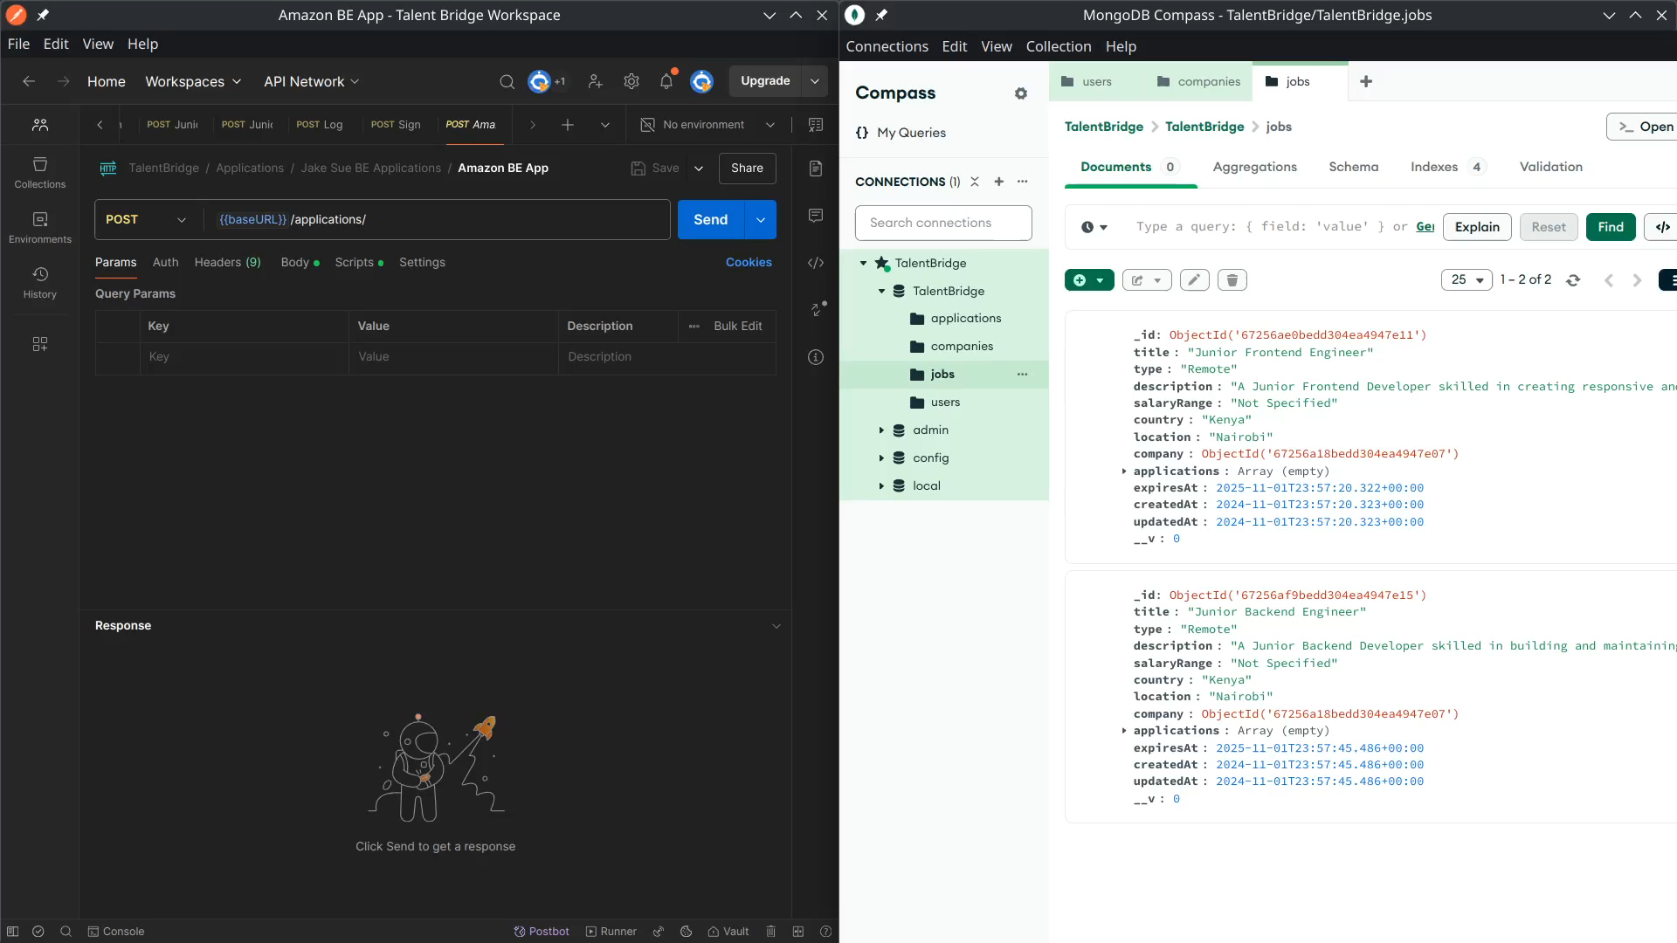

Slide 18
03
/applications
Delete Applications

Slide 19
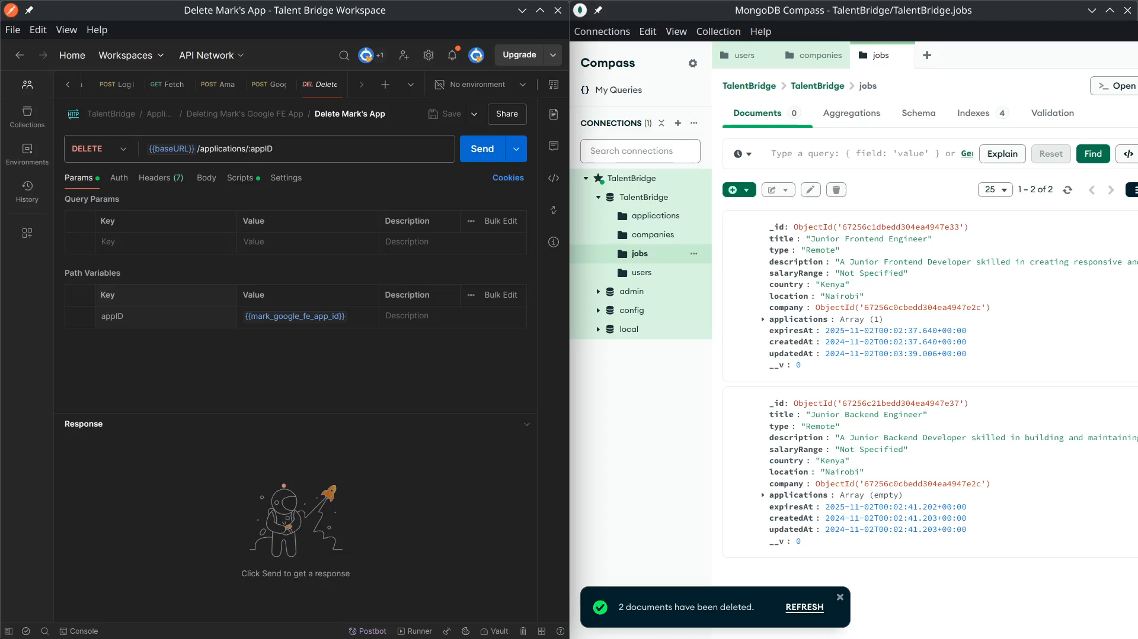

Slide 20
03
/applications
Handling Applications

Slide 21
